Slide 1
DATABASE PROJECT
Group 1: Dmytro Shutenko, Nathalie Schlech, Wei-Chieh Wang
05-01-2023
Supervisor: Prof. Simon Pierre Dembele

Slide 2
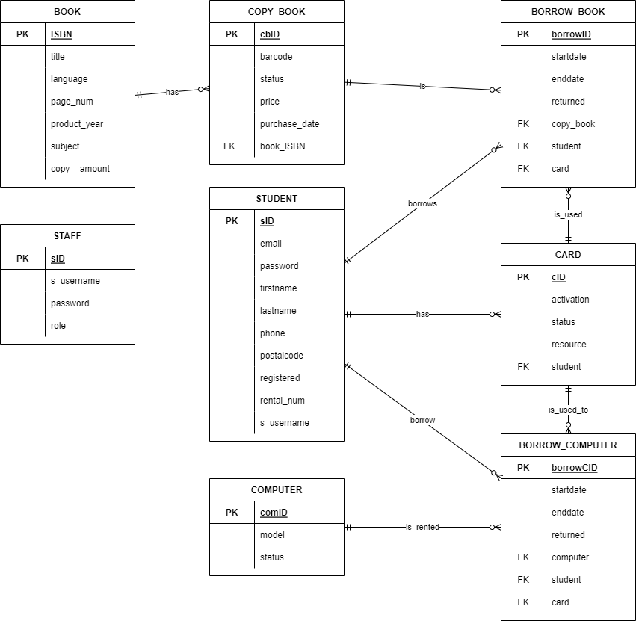
CRM-Diagram

Slide 3
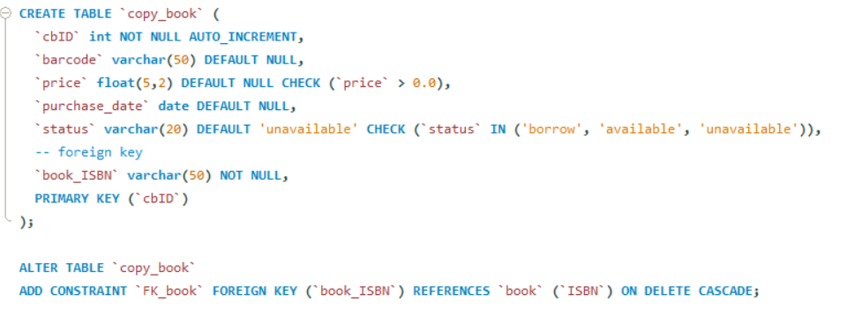
Table Creation

Slide 4
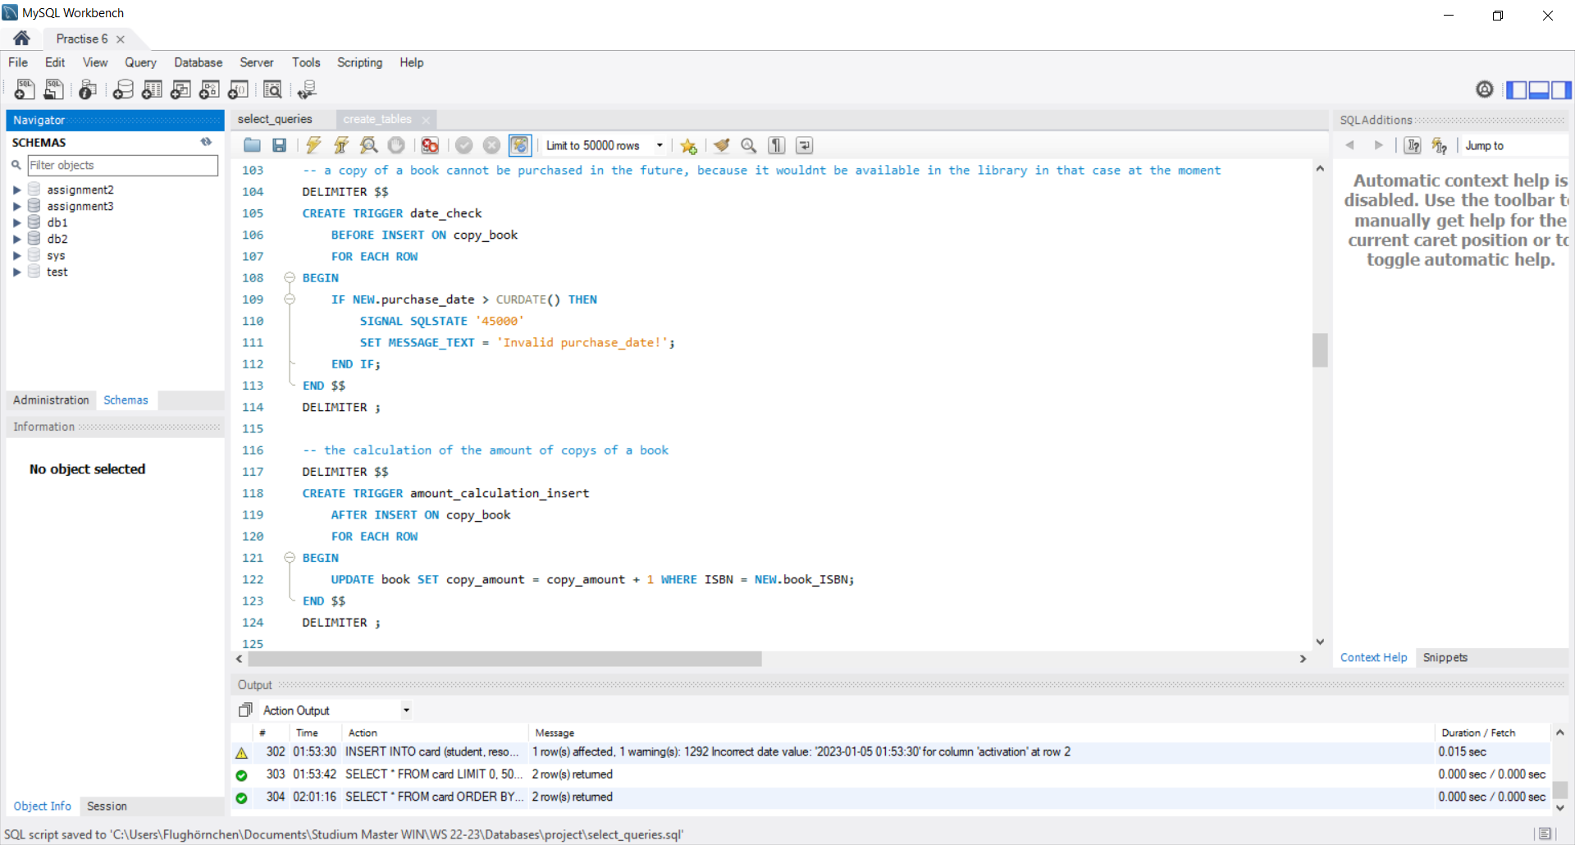
Triggers

Slide 5
Triggers

Slide 6
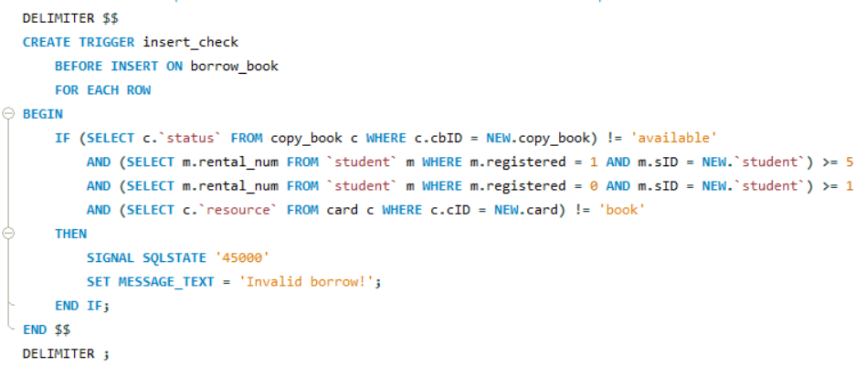
Triggers

Slide 7
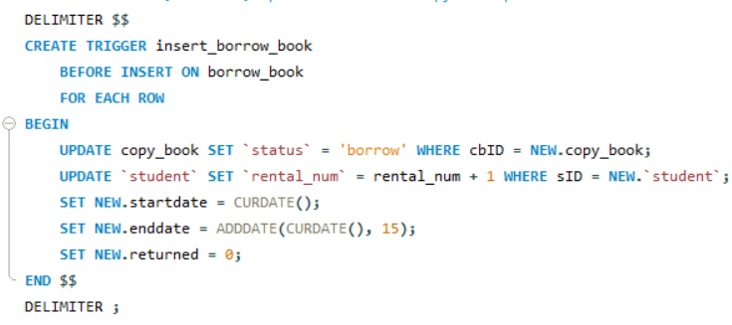
Triggers

Slide 8
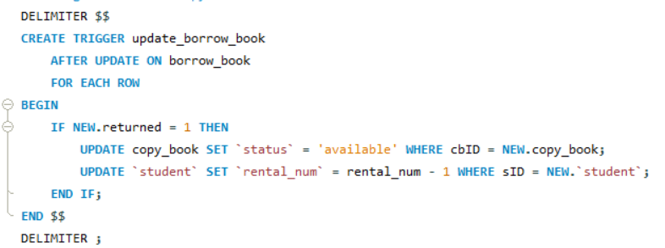
Triggers

Slide 9
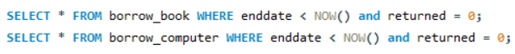
Exemplary SQL Query

Slide 10
SWITCH TO WEB INTERFACE

Slide 11
Admin
Create new students + cards
Activate or deactivate a card
Add computers, books, copy of books

Slide 12
Librarian
List students
Borrow process
Return the resource
View the overdue resource

Slide 13
Student
View all the available resource
Change the password
List the current loan

